Slide 1
Comparative Analysis of Different Deep Learning Models to Classify Infectious Diseases from Chest Radiological Images
Md Hasibur Rahman
ID : 211-15-14616
And
Kashfea Kafi
ID : 211-15-14578
Department of CSE
Daffodil International University
Md. Sadekur Rahman
Assistant Professor
Department Of CSE
Daffodil International University

Slide 2
Outline
Introduction
Motivation
Objective
Expected Outcomes
Related Works
Methodology
Results & Analysis
Conclusion
References
Q & A

Slide 3
Introduction
Respiratory diseases such as COVID-19, tuberculosis, and pneumonia represent severe global health threats, with staggering morbidity and mortality rates across the globe (WHO, 2020). Chest radiological images have always been at the forefront of non-invasive diagnostic tools aiding in the early detection and ongoing monitoring of these conditions (Kelly et al., 2020). These images play a pivotal role in influencing patient management strategies and, consequently, health outcomes. However, the traditional method of manually analyzing these images is not only labor-intensive but also suffers from variability, often leading to inconsistent or even inaccurate results.

Slide 4
Motivation
1. Increasing Prevalence of Infectious Diseases
2. Need for Faster and Scalable Diagnostic Solutions
3. Potential for Early Detection and Improved Patient Outcomes
4. Reduction in Healthcare Costs and Resource Optimization

Slide 5
Objective
Design and implement a range of deep learning architectures, including VGG19, ResNet50, and a Custom CNN to classify chest radiological images across five key categories: COVID-19, Lung Opacity, Normal, Viral Pneumonia, and Tuberculosis.
Optimize the performance of these models to achieve superior classification accuracy in diagnosing infectious respiratory diseases.
Focus on improving accuracy and efficiency specifically with the Custom CNN model.
Identify areas for further improvement to advance the field of chest radiological image classification.

Slide 6
Expected Outcomes
Accurate classification of chest radiological images: Successful implementation of VGG19, ResNet50, and a Custom CNN will enable the accurate classification of chest radiological images across five categories: COVID-19, Lung Opacity, Normal, Viral Pneumonia, and Tuberculosis.
Improved diagnostic capabilities: Optimized deep learning models will demonstrate superior classification accuracy in diagnosing infectious respiratory diseases, leading to better diagnostic performance compared to traditional methods.
Enhanced Custom CNN performance: The Custom CNN model will show improved accuracy and efficiency in classifying chest radiological images, highlighting its potential as a more effective tool in medical imaging tasks.
Benchmarking and identification of gaps: Through comparison with traditional deep learning architectures, the study will establish benchmarks for model performance and identify areas for future research, contributing to advancements in chest radiological image classification.

Slide 7
Related Works
Authors | Model | Dataset | Advantages | Limitations
L. Silva, L. Araujo | InceptionResNetV2 | X-ray images of children | High recall and precision in detecting pneumonia | Lacks comperative analysis of various models and there is no mention of Grad-CAM.
Yogesh H. | Deep CNN Network | Radiology X-ray images of COVID-19, Pneumonia, Normal | Achieved high accuracy of 92% in classification | Lacks comperative analysis of various models and there is no mention of Grad-CAM.
V Asha et al. | ResNet101 | COVID-19 Dataset | Enhanced ResNet-101 Model for Effective Classification of COVID-19 Disease | High computional cost and limited classification.
NO Adiwijaya et al. | CNN Network | Chest X-ray images | Employs CNN for infectious lung diseases using Kaggle data | Effective but constrained by dataset limitations and absence of explainability.

Slide 8
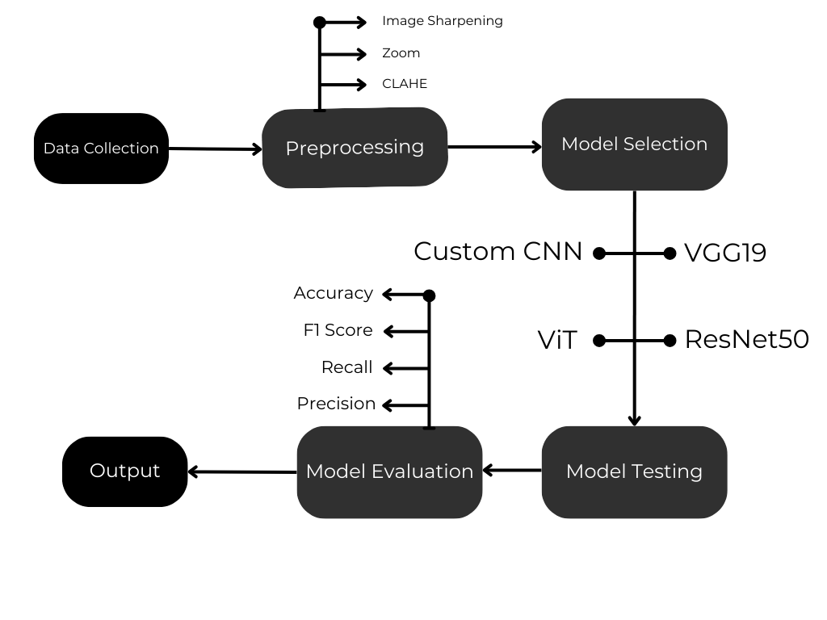
Methodology

Slide 9
Result and Analysis
Sl | Model Name | Loss | Test Accuracy | Precision | Recall | AUC | F1 Score
0 | VGG19 | 0.15 | 0.94 | 0.94 | 0.94 | 0.99 | 0.94
1 | CustomCNN | 0.20 | 0.97 | 0.92 | 0.92 | 0.99 | 0.92
2 | ResNet50 | 0.22 | 0.93 | 0.93 | 0.93 | 0.99 | 0.93
3 | ViT | 0.66 | 0.79 | 0.81 | 0.76 | 0.95 | 0.78

Slide 10
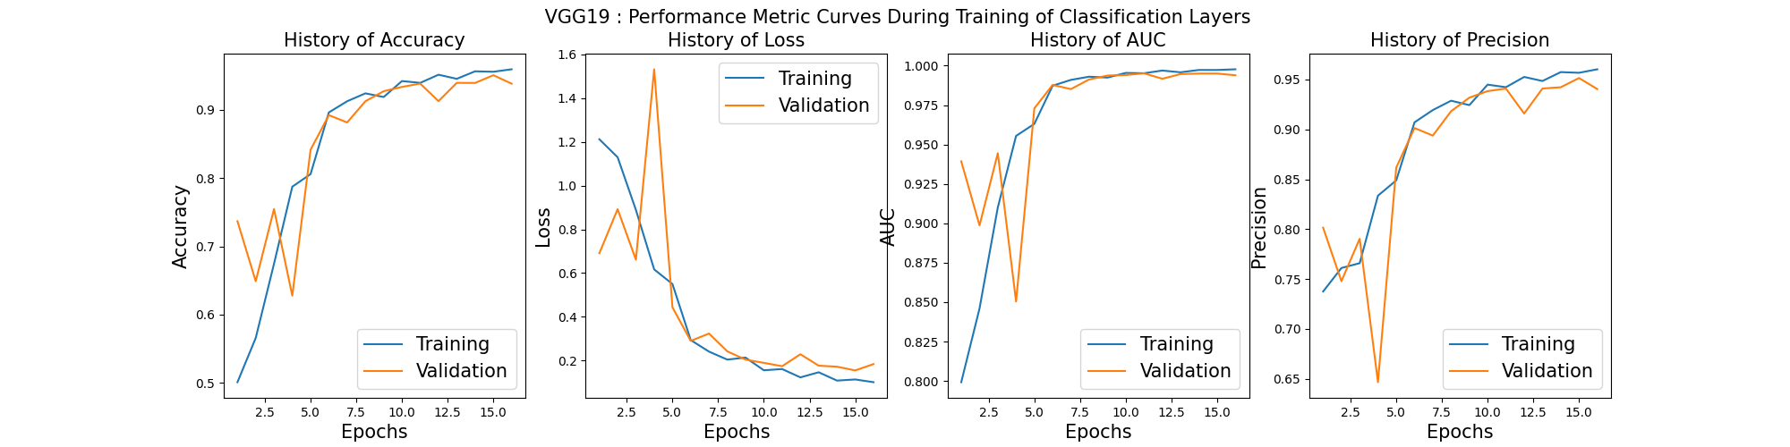
VGG19
During this phase there was a decrease in loss for both the training set and the validation set. The metrics like accuracy, precision, and recall increased; hence, the model got better at classifying images correctly.

Slide 11
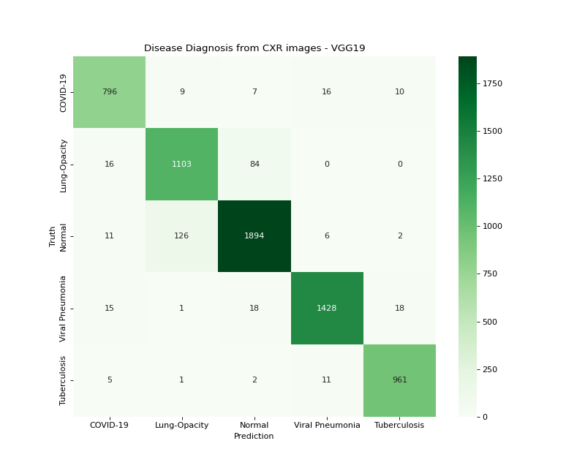
VGG19 Confusion Matrix

Slide 12
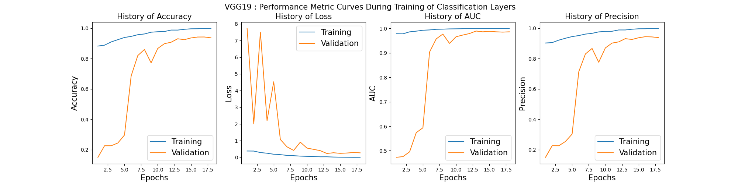
ResNet50
ResNet50, used in the transfer learning setup, showed very good adaptability, similar to that of the VGG19 model. All the performance metrics continued to improve, especially accuracy, precision, and recall, which showed how well this model had learned from previous knowledge and was able to adapt that to our dataset.

Slide 13
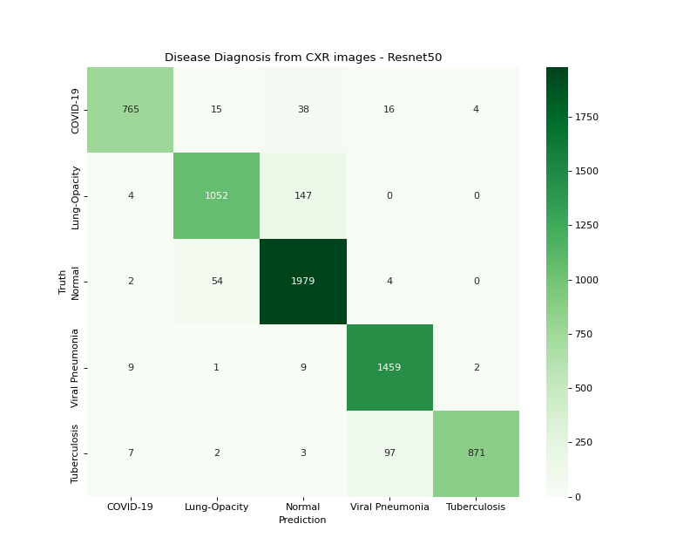
ResNet50 Confusion Matrix

Slide 14
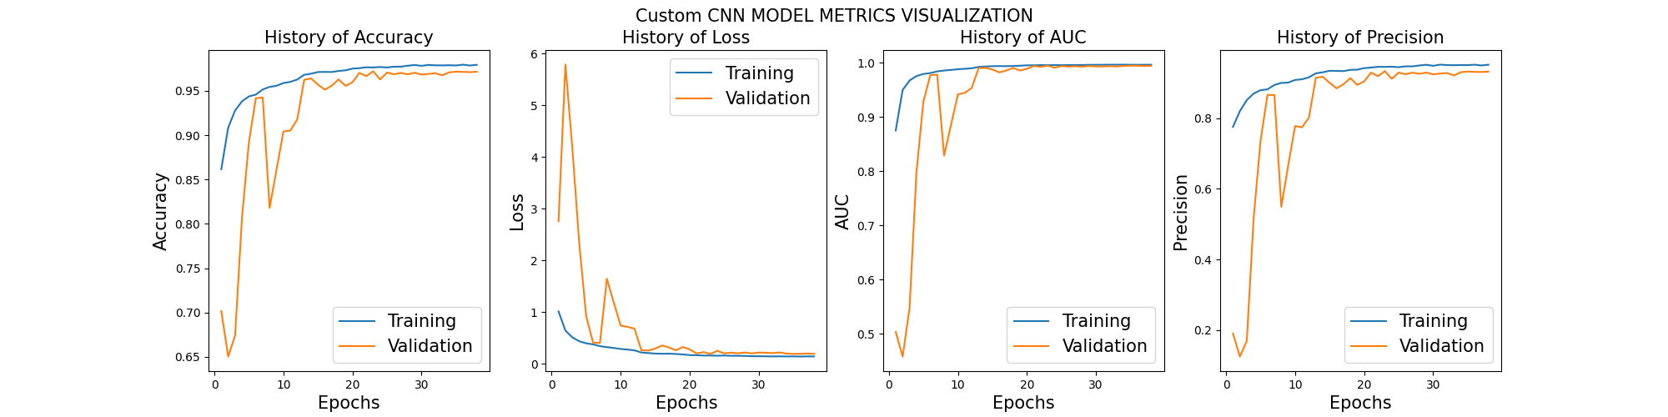
Custom CNN
Custom CNN demonstrated favorable convergence behaviors for both training and validation sets. The training loss exhibited a consistent downward trend, aligning with the anticipated optimization patterns as shown.

Slide 15
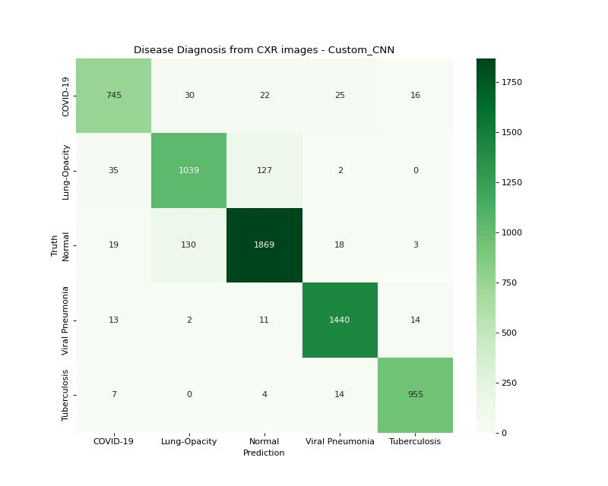
Custom CNN Confusion Matrix

Slide 16
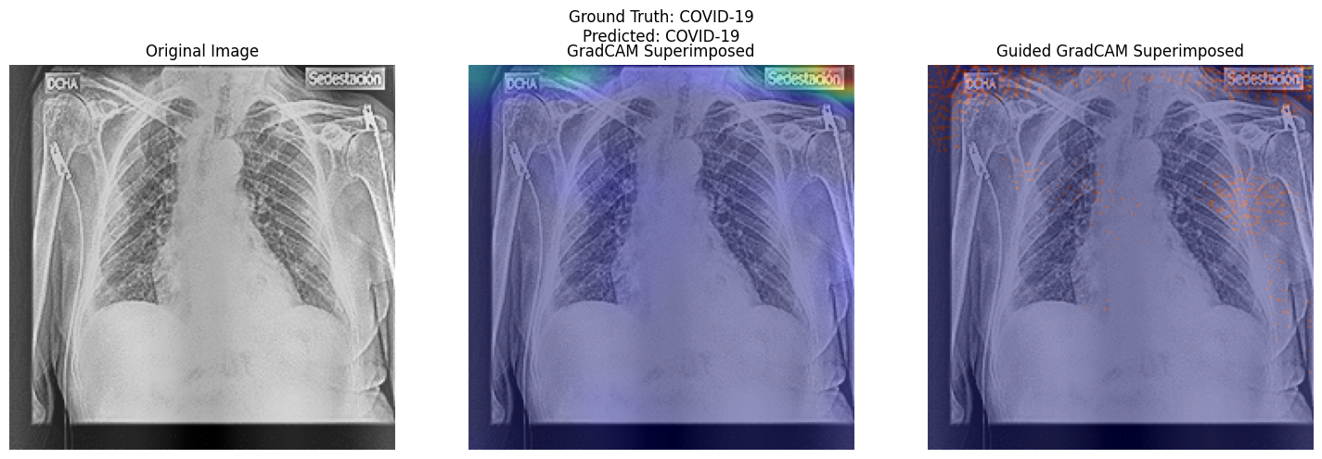
Grad Cam with Guided Grad Cam
This technique uses Grad CAM to highlight image areas that activate neurons in deeper model layers. However, it focused on peripheral artifacts instead of clinically relevant areas, possibly due to a lack of zooming during pre-processing. Guided Grad CAM improves resolution by combining backpropagation and Grad CAM, visualizing feature importance throughout the network. While later layers focused on noise (like edges), analyzing earlier layers can help identify patterns related to clinical features.

Slide 17
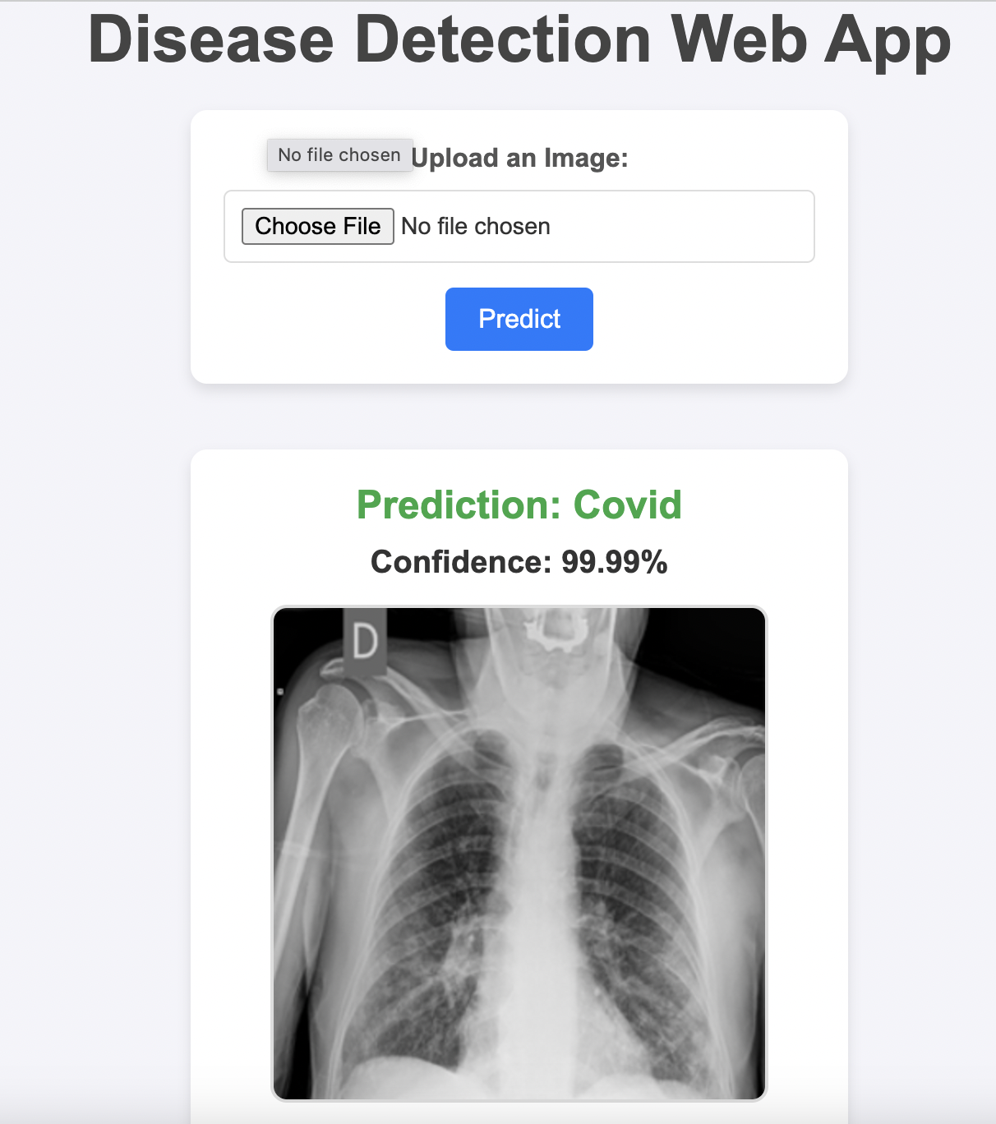
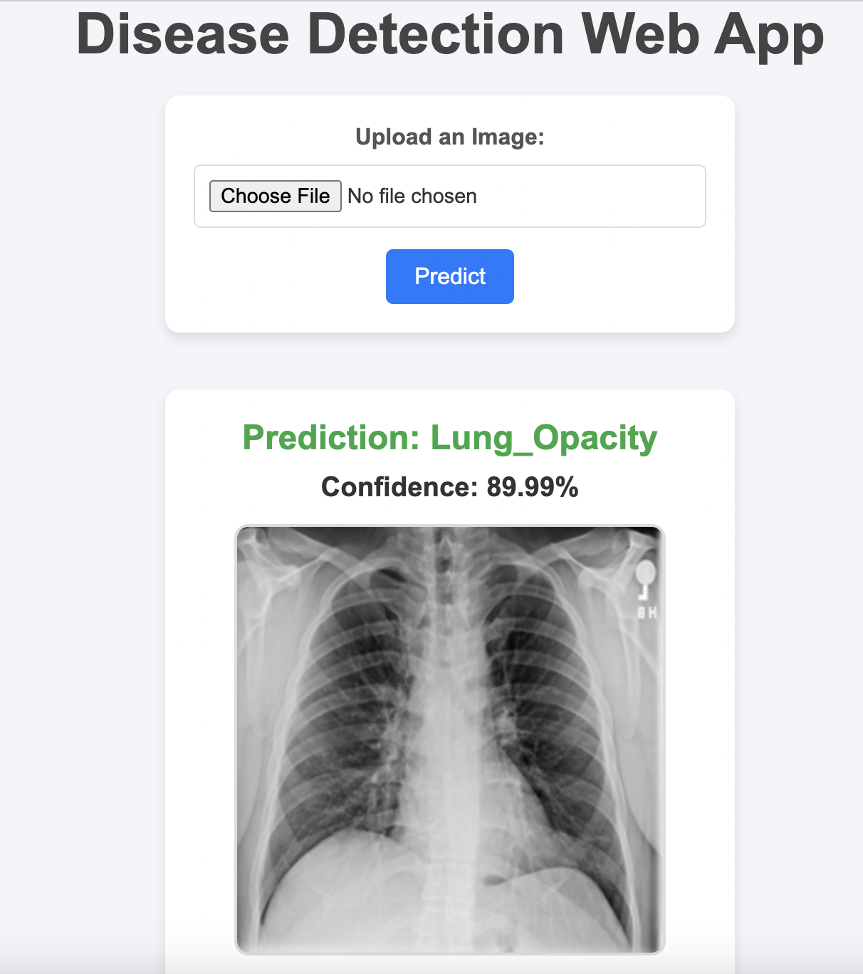
Web App

Slide 18
Conclusion
This study compared traditional CNNs (VGG19, ResNet50) and a custom CNN architecture for classifying infectious respiratory diseases in chest radiological images. The results highlighted the superior performance of traditional CNNs and the custom architecture, while emphasizing the importance of interpretability through visualization techniques to bridge AI and clinical practice.

Slide 19
References
[1] S. M. Pizer, et al., “Adaptive histogram equalization and its variations,” Computer Vision, Graphics, and Image Processing, vol. 39, no. 3, pp. 355–368, 1987.
[2] P. Rajpurkar, J. Irvin, R. L. Ball, K. Zhu, B. Yang, H. Mehta, et al., “Deep learning for chest radiograph diagnosis: A retrospective comparison of the CheXNeXt algorithm to practicing radiologists,” PLoS Medicine, vol. 15, no. 11, p. e1002686, 2017.
[3] X. Wang, Y. Peng, L. Lu, Z. Lu, M. Bagheri, and R. M. Summers, “ChestX-ray8: Hospital-scale chest X-ray database and benchmarks on weakly-supervised classification and localization of common thorax diseases,” in Proceedings of the IEEE Conference on Computer Vision and Pattern Recognition, 2017, pp. 2097–2106.
[4] A. Dosovitskiy, L. Beyer, A. Kolesnikov, D. Weissenborn, X. Zhai, T. Unterthiner, et al., “An image is worth 16x16 words: Transformers for image recognition at scale,” arXiv preprint arXiv:2010.11929, 2020.
[5] F. Chollet, “Xception: Deep learning with depthwise separable convolutions,” in Proceedings of the IEEE Conference on Computer Vision and Pattern Recognition, 2017, pp. 1251–1258.

Slide 20
References
[6] K. He, X. Zhang, S. Ren, and J. Sun, “Deep residual learning for image recognition,” in Proceedings of the IEEE Conference on Computer Vision and Pattern Recognition, 2016, pp. 770–778.
[7] Y. LeCun, Y. Bengio, and G. Hinton, “Deep learning,” Nature, vol. 521, no. 7553, pp. 436–444, 2015.
[8] P. Rajpurkar, J. Irvin, K. Zhu, B. Yang, H. Mehta, T. Duan, et al., “Chexnet: Radiologist-level pneumonia detection on chest X-rays with deep learning,” arXiv preprint arXiv:1711.05225, 2017.
[9] R. R. Selvaraju, M. Cogswell, A. Das, R. Vedantam, D. Parikh, and D. Batra, “Grad-CAM: Visual explanations from deep networks via gradient-based localization,” International Journal of Computer Vision, vol. 128, no. 2, pp. 336–359, 2020.
[28] A. Basu, S. Das, S. Ghosh, S. Mullick, A. Gupta, and S. Das, “Chest X-Ray Dataset for Respiratory Disease Classification,” Harvard Dataverse, Jan. 2021, doi: https://doi.org/10.7910/dvn/wnq3gi.

Slide 21
THANK YOU

